Slide 1
Sam’s slides to be inserted into presentation
Sam’s slides to be inserted into presentation

Slide 2
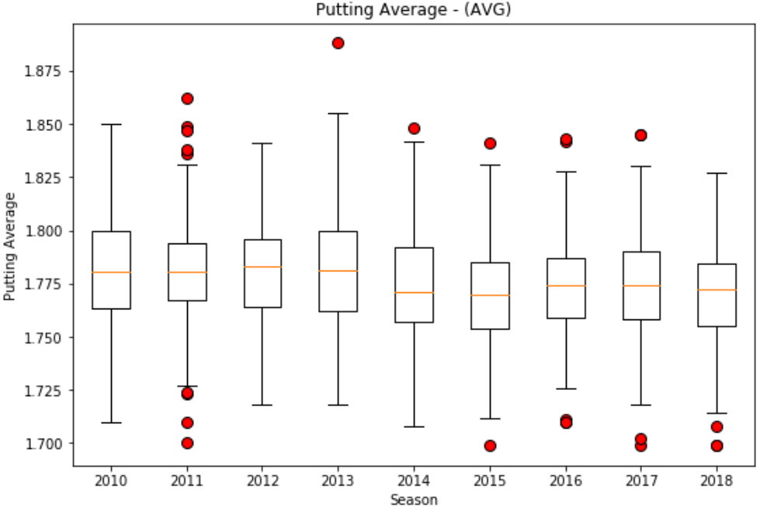
Putting Average – Box Plot
Notes:
Speaker:
As you can see on the box plot, there has been notable oscillations of the median line and the IQR over the seasons.
However, oscillations all remained close to 1.775 for the putting average. There is not a clear trend over time.

Slide 3
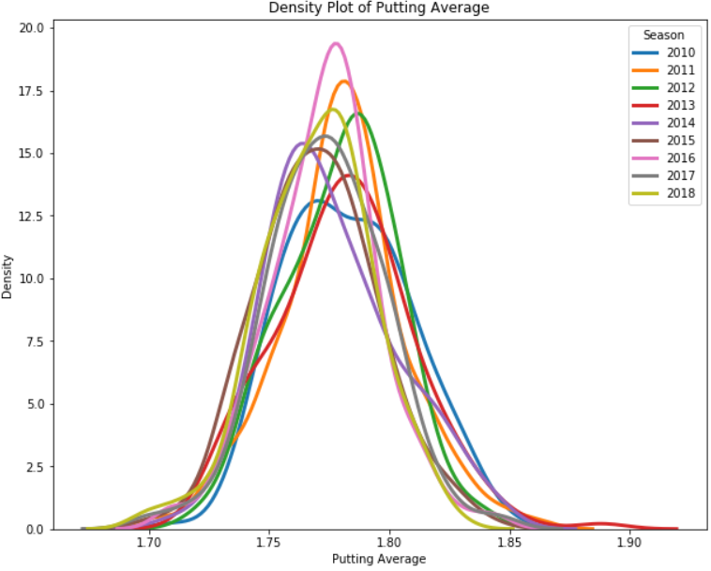
Putting Average – Density Plot
Notes:
Speaker:
As you can see on the density plot, there are shifts in the curve for each season. However, there is not a sequential or near sequential pattern with the seasons, so there no clear trend over time.

Slide 4
Putting Average – ANOVA and Tukey
One-Way ANOVA
F-Statistic = 6.991
P-Value = .00000004218
The P-value is less than 0.05. Therefore, there are significant differences among the means.
Tukey
10 of the 36 pairwise comparisons between seasons show the that the P-value is less than 0.05. Therefore, there are significant differences between those pairs of means.
Notes:
Speaker:
The One-Way ANOVA and the Tukey indicate that there are significant differences among the means for each season.

Slide 5
Putting Average – Conclusion
The One-Way ANOVA and Tukey show that there are significant differences among the averages.
The box plot, density plot, and line graph show that there is no clear trend over the seasons.
Thus, there appears to be significant oscillations of the putting average between seasons, but no clear trend over time.
The putting element of the PGA Tour does not seem to be impacted by improved technology between the 2010 to 2018 seasons.
Notes:
Speaker:
Read Slide

Slide 6
Separate Section Follows This
Separate Section Follows This

Slide 7
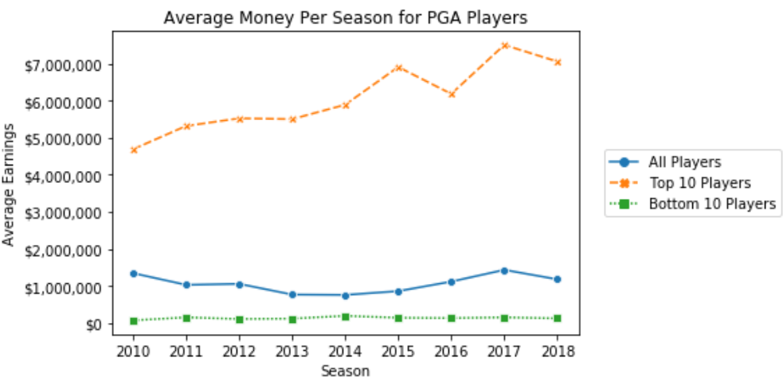
Money Earned
Notes:
Speaker:
This additional section is just to touch upon a topic of interest – money and performance. This line graph is for context on how earnings have changed over the seasons for PGA Tour players. As you can see, the top 10 players have a clear increasing trend; whereas, earnings for the rest of the players have been relatively flat over the seasons. We will also examine this with three of the most notable player who played consistently during 2010-2018.

Slide 8
Money Earned and Performance
Correlation | Total Money (Official and Unofficial)
Driving Distance | 0.33
Smash Factor | 0.06
Short Game Rating | 0.20
Proximity to Hole | -0.19
Putting Average | -0.46
Notes:
Speaker:
The statistics with the best correlation to money earned are driving distance and putting average; whereas, the smash factor has relatively little impact on earnings.
This is possibly because the smash factor is a ratio of club speed to ball speed and not a measure of progress toward the hole.

Slide 9
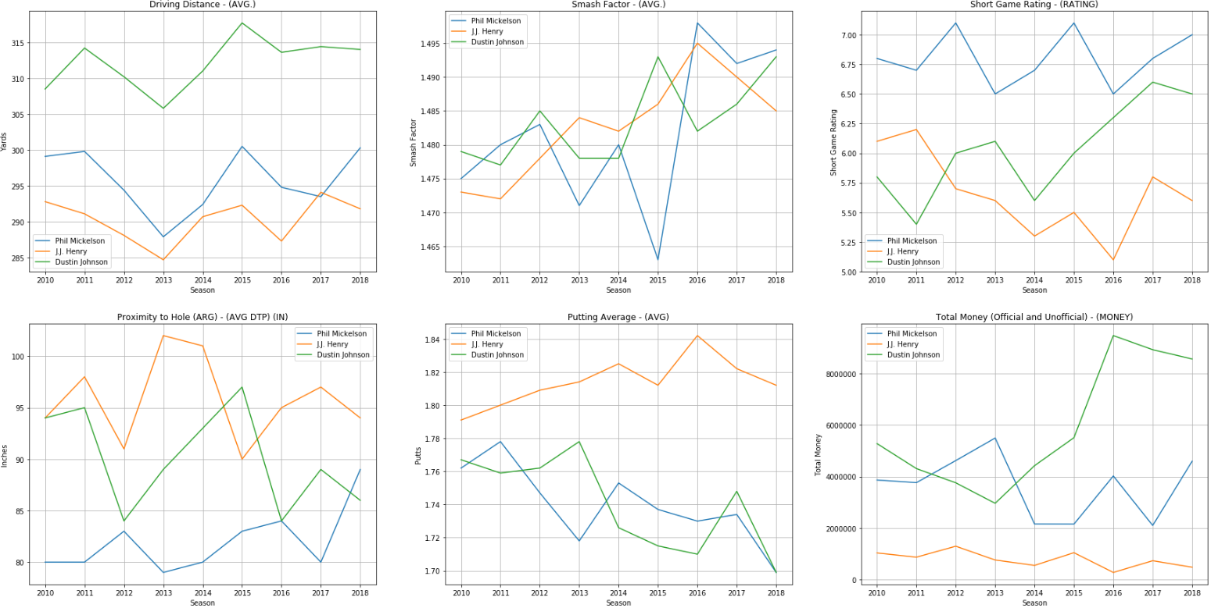
Selected Players’ Performance
Notes:
Speaker
We selected Phil Mickelson, J.J. Henry, and Dustin Johnson to take a closer look at because they are well known. This illustrates the much greater variability that individuals will have versus their population.

